Slide 1

Task#10-Inference Mapping
T.BHAVANI-23781 A05F0
U.G.WAJIHA-23781A05F1
V.LAHARI-23781A05F5
V.YESHWITHA-23781 A05F6
V.P.LALITHA-23781A05F7
V.SIREESHA-23781A05F8
V.SUPRAJA-23781A05F9

Slide 2

Railway Ticketing Management System
Inference Mapping Process

Slide 3
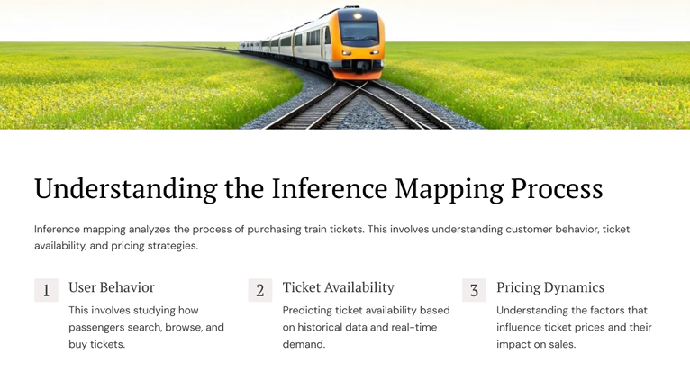
Inference mapping analyzes the process of purchasing train tickets. This involves understanding customer behavior, ticket availability, and pricing strategies. 1) User Behavior This involves studying how passengers search, browse, and buy tickets. 2) Ticket Availability Predicting ticket availability based on historical data and real-time demand. 3) Pricing Dynamics Understanding the factors that influence ticket prices and their impact on sales.
Understanding the Inference Mapping Process

Slide 4

Feature Engineering and Selection .
Creating new features from existing data to improve model performance and selecting the most relevant features for model training.
Time of Day
The time of day impacts ticket demand and pricing.
Day of Week
Weekends and holidays have different demand patterns.
Route Distance
Distance influences travel time and ticket price.

Slide 5
Data Collection and Preprocessing Gathering and cleaning data from various sources, including booking systems, passenger databases, and external travel information sources.
Data Sources
Preprocessing
Booking Systems
Passenger Databases
External Travel Information
Data Cleaning
Data Transformation
Feature Scaling

Slide 6
Model Development and Training
Choosing a suitable model for predicting ticket demand and training it on the prepared data to learn patterns and relationships
Description
Predicting ticket demand based on linear relationships between features.
Creating a tree-like structure to make decisions based on specific conditions.
Learning complex patterns and making predictions based on interconnected nodes.
Model Types
Linear Regression
Decision Trees
Neural Networks

Slide 7
THNK YOU

